Slide 1
Advanced OS Topics Home Remote Solution
Guided by: Nezer Zaidenberg
Submitted By:
Yosi Zilberberg (062852249)
Yossi Naor (034217091)

Slide 2




Solution GOAL
Home Automation System for Managing Devices
Location Based Control using Android Application
Device Registration via Zero Configuration Protocol

Slide 3
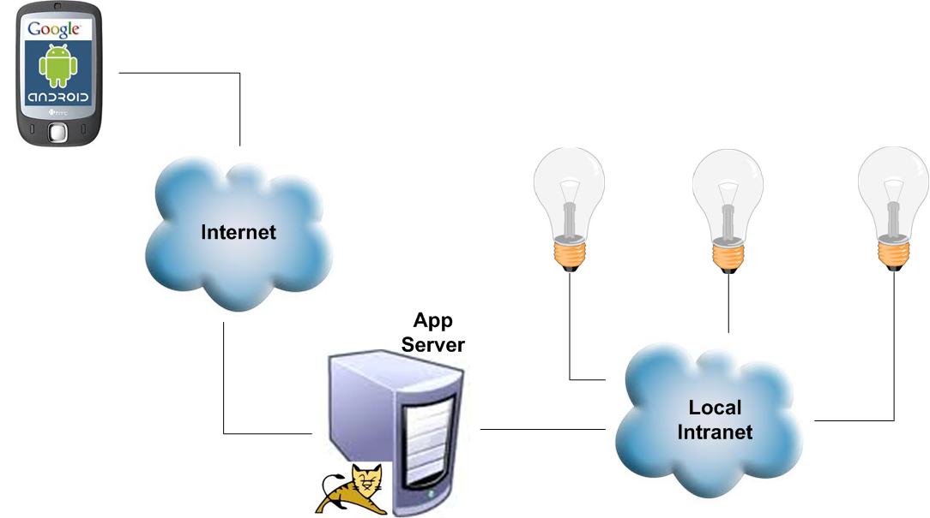
Architecture Overview

Slide 4
Main Use Cases
Application Side
Complete View of Device Status
Location Based Rules for Switching Device (On/Off)
Manual Device Switch (On/Off)
Server Side
Register / Unregister Devices
Assign Devices into Zones
Control Devices State
By User Location
By User Request

Slide 5
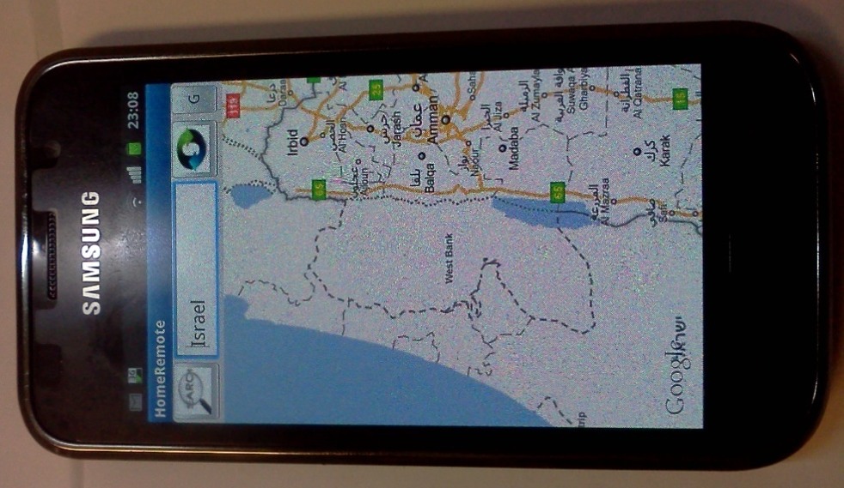
Home Remote
App for Android OS

Slide 6
Main features
Walk and Control
Just turn the Home Remote application and your devices will be switched on/off according to your GPS position
Map Control
Allows you to control your devices by setting your location within a map
Manual Mode
Switch on/off devices (unbounded to GPS position)

Slide 7
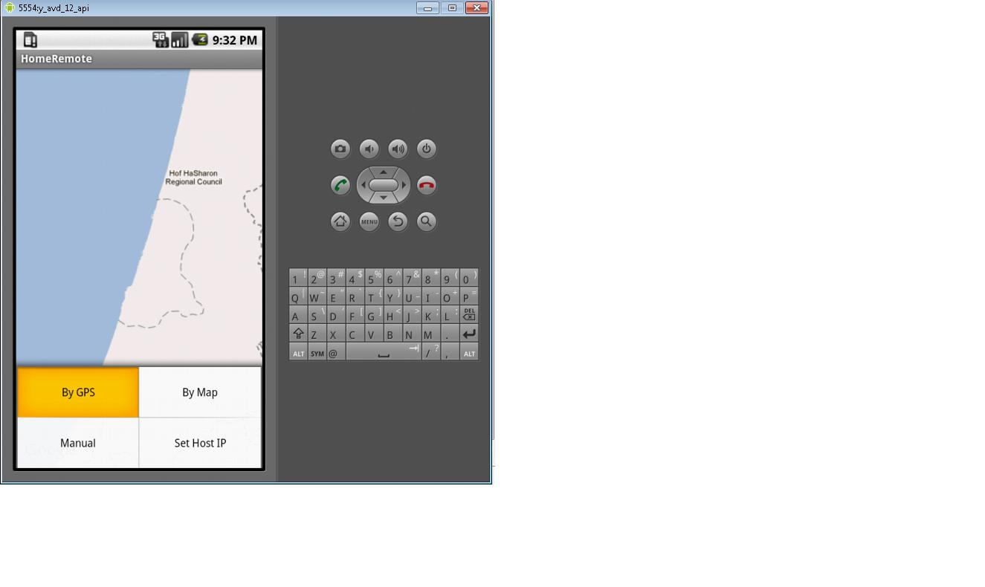
Walk and Control
“Automatic Mode”
Device can be assigned to a “Switch-Rule”
When a user moves with his mobile the appropriate devices will be switched on/off according to the GPS location

Slide 8
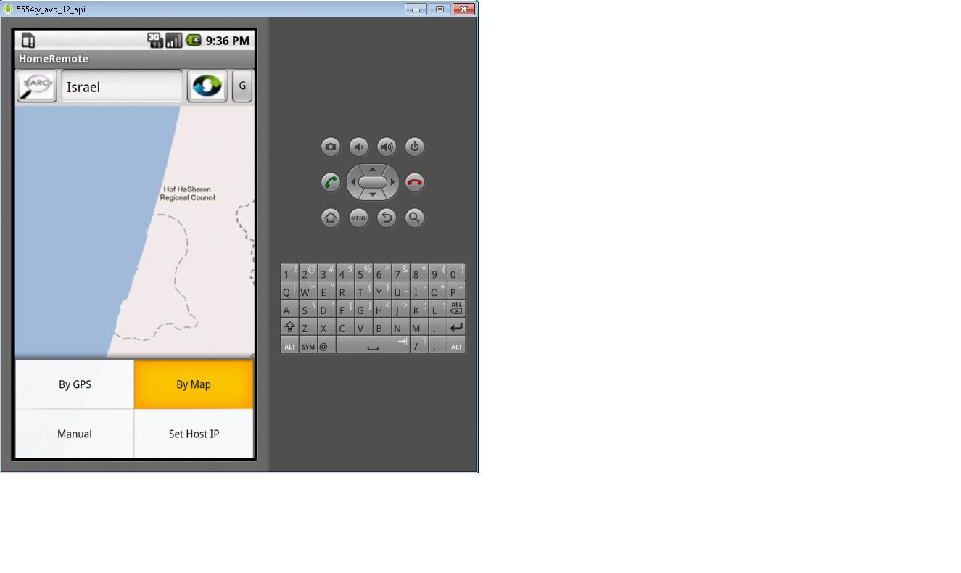
Map Control
For Simulating Location
Search location
Send map coordinates that emulate GPS location
Move around

Slide 9
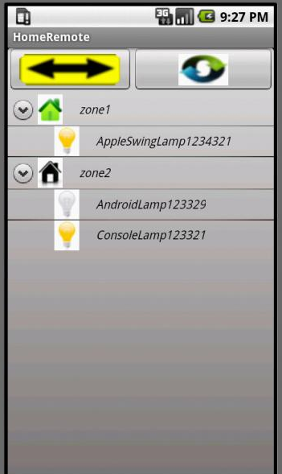
Manual Mode
View/Modify Device Status
Accomplish the change update
Refresh current devices status
Change status by click

Slide 10
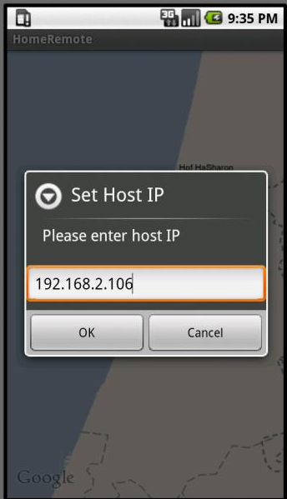
Application Settings
Change host IP
Switch between application modes

Slide 11

Home Remote
App for Android OS
Behind the Scenes

Slide 12
SDK Platform
Install Android SDK
Download SDK platform needed for development
Use the minimum platform SDK version for backwards compatibility
Home Remote requires SDK platform 1.6
Install the ADT Plug-in for Eclipse
Target the Eclipse Android SDK settings to the installed location
Select/create virtual device from “Android SDK and AVD manager”

Slide 13
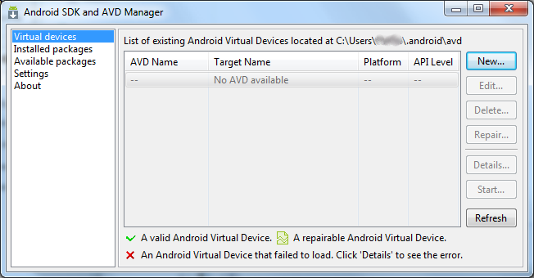
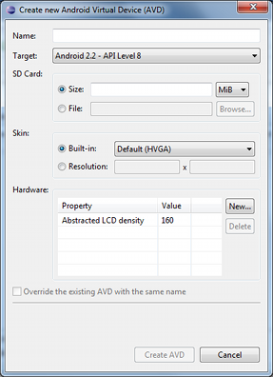
ADT Plug-in For Eclipse
Install the ADT Plug-in for Eclipse
Target the Eclipse Android SDK settings to the installed location
Create/Select virtual device from “Android SDK and AVD manager”

Slide 14
Main Components
MapView
View which displays a map
Data obtained from the Google Maps service
Registration for Google Maps service needed
http://code.google.com/intl/iw/android/add-ons/google-apis/mapkey.html
com.google.android.maps.MapView
LocationListener
Notifications Listener on Location Changed
android.location.LocationListener
Geocoder
Get Geo Coordinates from address
android.location.Geocoder

Slide 15

Home Remote
Server Side

Slide 16
Main Components
JMS (active MQ)
JDBC (hsqldb)
Jackson
JMDNS / Apple Bonjour (dns-sd)
Open EJBs (Session, Entities, MDBs)
Simple HTTP Servlets (http transport)
Web Services (managing zones & devices)

Slide 17
Registration Process
Registration Event
(DNS-SD)
Send JMS Update Message
(For Asynchronous Update)
On Message Event
(JMS Message)
Update DB
(using session EJB with JPA)

Slide 18
Device List
Http Request (Servlet)
Query Devices (using session EJB with JPA)
Assemble JSON Response (using Jackson API)
Http Response (Servlet)

Slide 19
Location Update
Http Request (Servlet: parameters encoded using JSON)
Update Device Location (if needed change device status, using session EJB & JPA)

Slide 20
Periodically Status Check
Periodically Status Check (For all Registered Devices)
Get
Device Info
Load Device Driver
Check Device State
Persist Device State

Slide 21
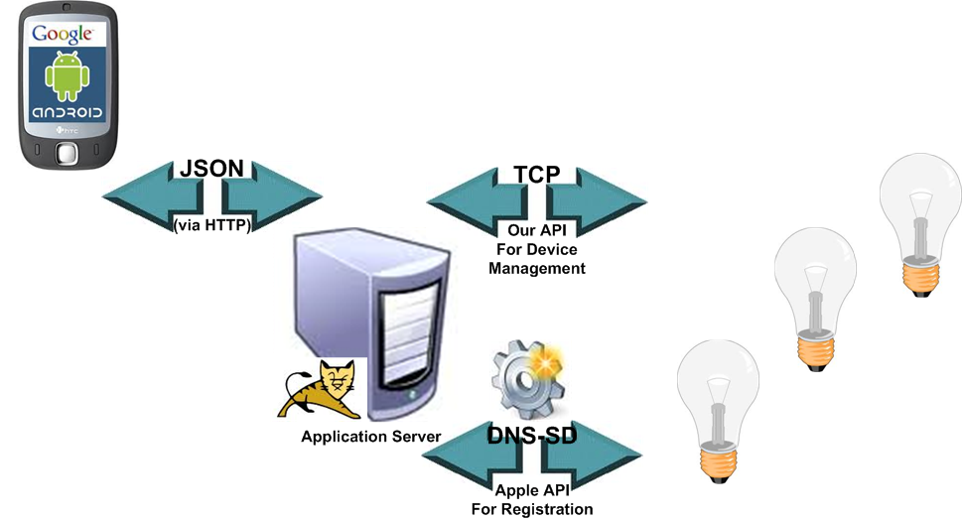
Architecture

Slide 22
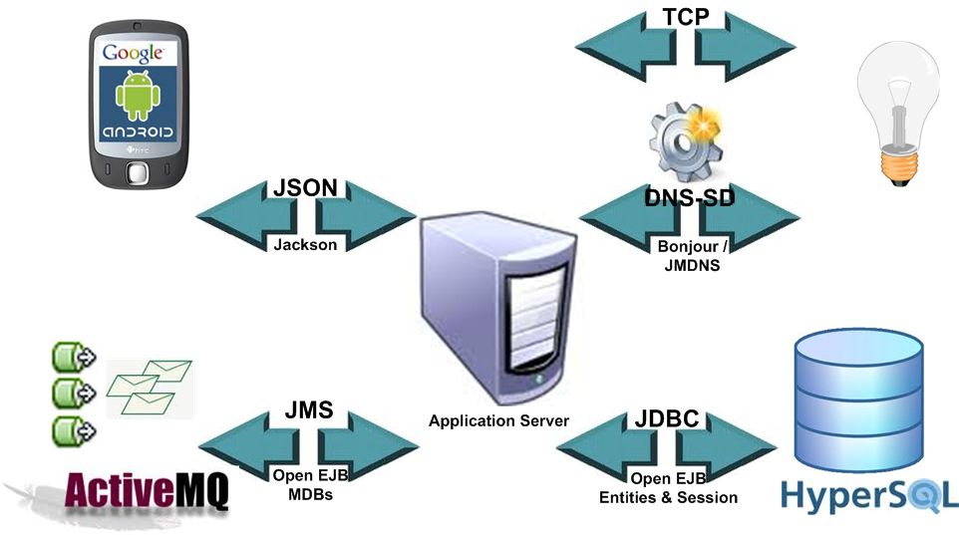
Architecture(2)

Slide 23

Home Remote
Lamp Simulators

Slide 24
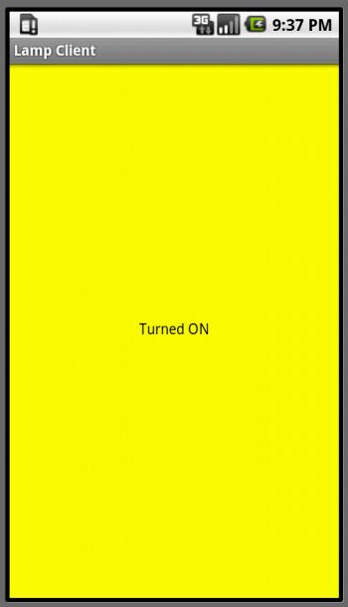
Android Lamp Simulator
Based on JmDNS API
Pure Java implementation for multi-cast DNS (Zeroconf)
Registration to Home Remote Solution
Modify Lamp Status
Switch on/off by Home Remote application

Slide 25

Java Swing Lamp Simulator
Based on Bonjour Apple API
Using Java implementation (dns-sd) for multi-cast DNS
Registration to Home Remote Solution
Modify Lamp Status
Switch on/off by Home Remote application
Executed on Win OS

Slide 26
C++ Lamp Simulator (Linux)
Key Architectural Design
Avahi API (dns-sd implementation for Linux)
Boost Framework
Managing Threads
Handling TCP Sockets
Executed on Linux OS (ubuntu)
Registration to Home Remote Solution
Modify Lamp Status
Switch on/off by Home Remote application

Slide 27
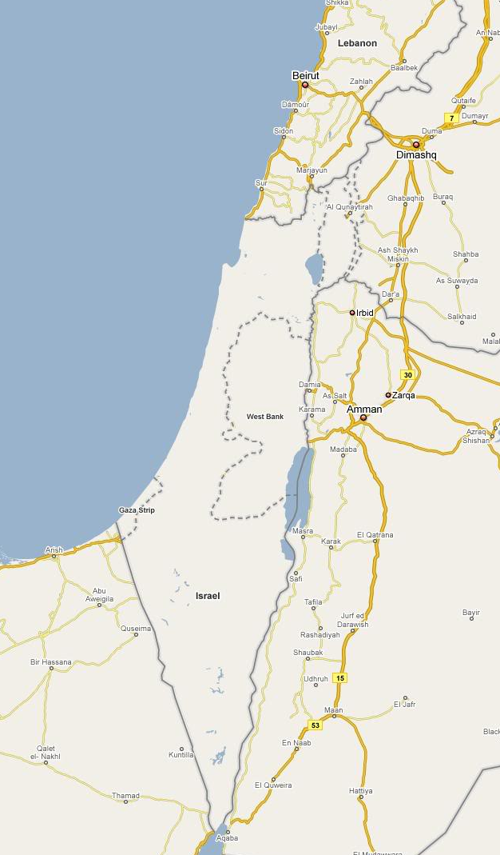
Simulation
Every zone have a location
Lamp is assigned to zone
Each lamp in zone may have different distance switch
Zone Location

Slide 28
Questions?
All source/binaries can be found at:
http://code.google.com/p/zeroconf-for-android/

